Slide 1
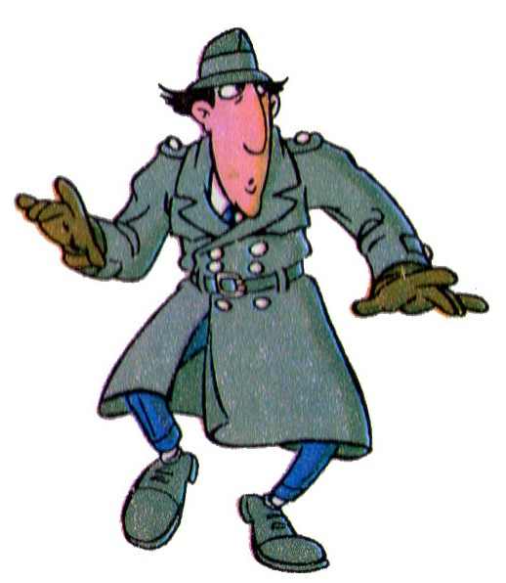
VIDEOCONFERENCE N°3

Slide 2
GAME n°1 : Height and shoe size

Slide 3
Listen…. and Write
….

Slide 4
Jack | Suzan | Simon | Luke | Rachel | Sarah | Helen | Richard
1,64 | 1,66 | 1,45 | 1,12 | 1,33 | 1,58 | 1,71 | 1,87

Slide 5
Look…. and speak
….
GAME n°2 : 7 differences

Slide 6
7 differences
HAT
CAP
Amy Alix

Slide 7
Jack
Jim
7 differences
BEARD
MUSTACHE

Slide 8
GAME n°3 : Who is the robber ?

Slide 9
On Saturday, there was a hold-up in the Bank in Winchester Street at 11:00 pm. The police immediately came to investigate the crime scene and found some footprints in the snow. A neighbour saw the robber and the police made an identikit.

Slide 10
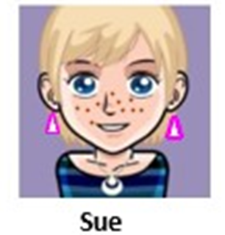
Listen…. and show
….

Slide 11
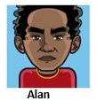
1,83
1,83
1,65
1,63
1,82
1,65
1,65
1,66
1,73
1,72
1,66
1,63

Slide 12
Look…. and speak
….

