Slide 1
Chanteloup
Source: Google Earth

Slide 2
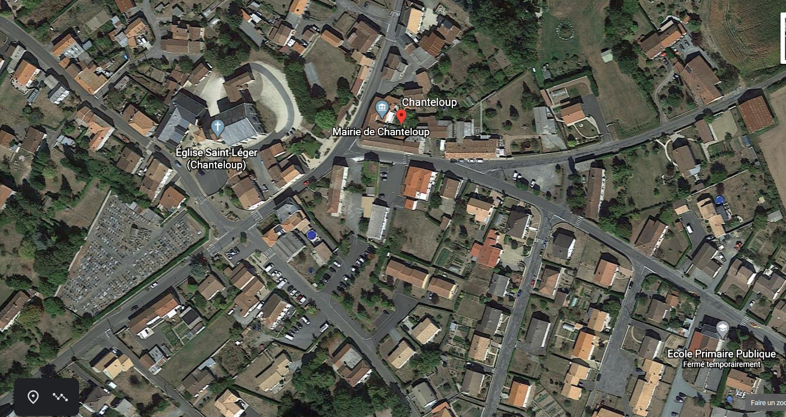
Chanteloup (centre bourg)
Source: Google Earth

Slide 3
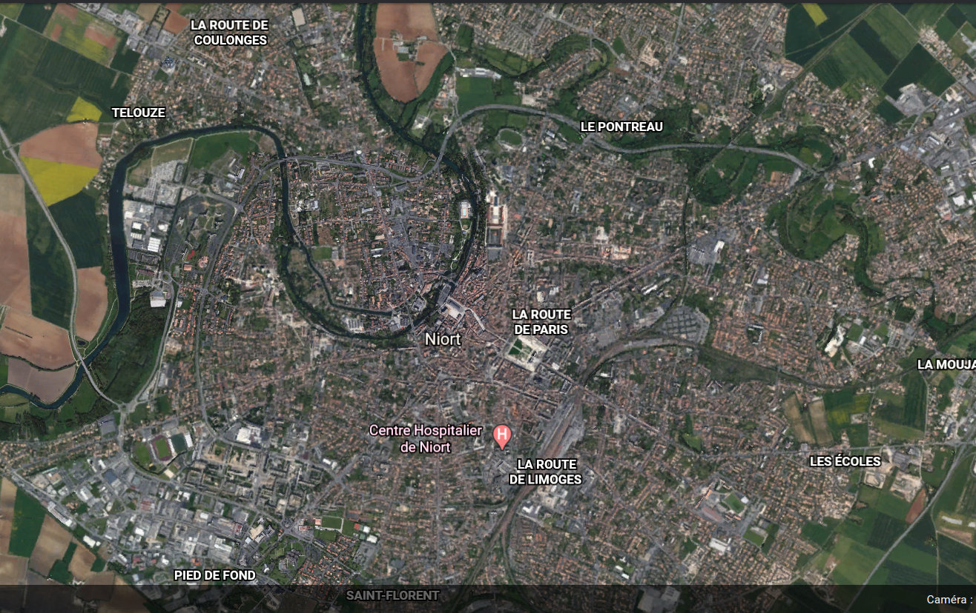
Niort
Source: Google Earth

Slide 4
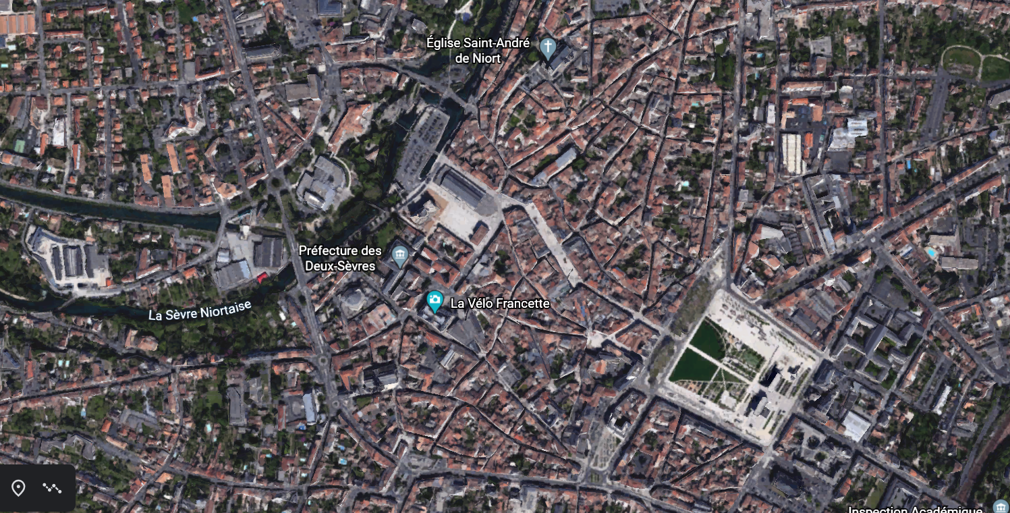
Niort (centre)
Source: Google Earth

Slide 5
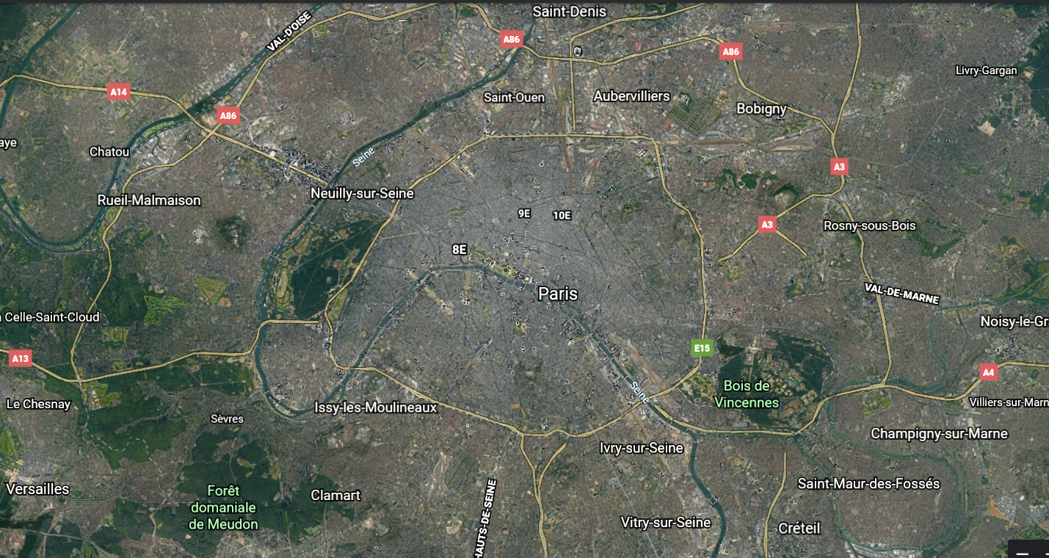
Paris
Source: Google Earth

Slide 6
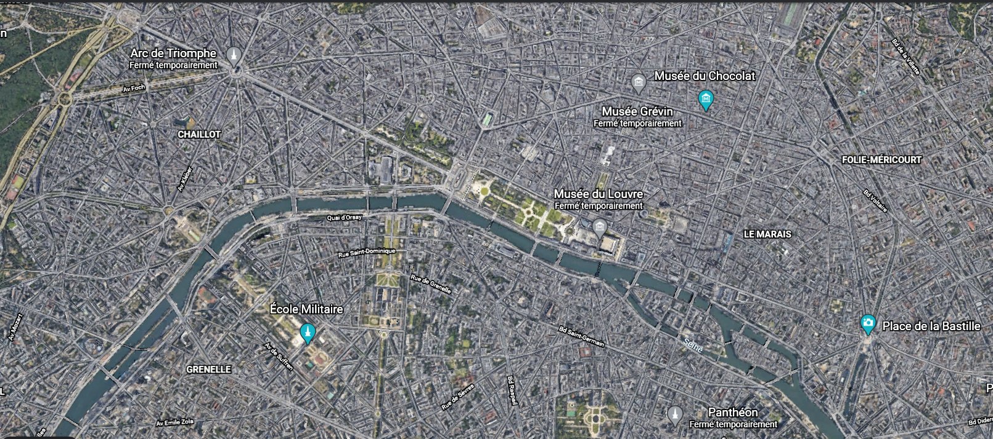
Paris (centre)
Source: Google Earth

